Slide 1
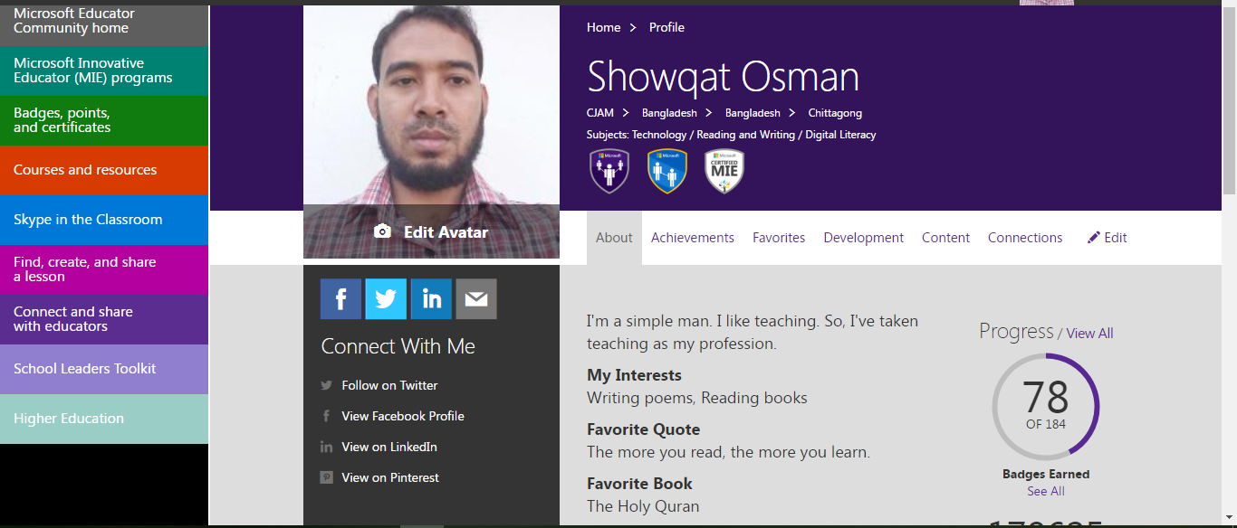
Yes, I am proud of being a Microsoft Innovate Educator.

Slide 2
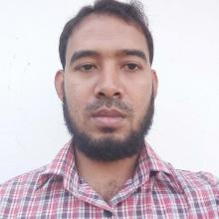
This is:
Showqat Osman
Assistant Teacher (English)
Chunati Hakimia Kamil (MA) Madrasah
Lohagara, Chittagong.
Mobile No: 01817756221
E-mail: showqatosman@gmail.com
Web: soenglishlearning.blogspot.com

Slide 3
Why I consider myself to be a….

Slide 4
I am a teacher of 21st century.
I am inspired to use technology for teach and inspire others to do it.

Slide 5
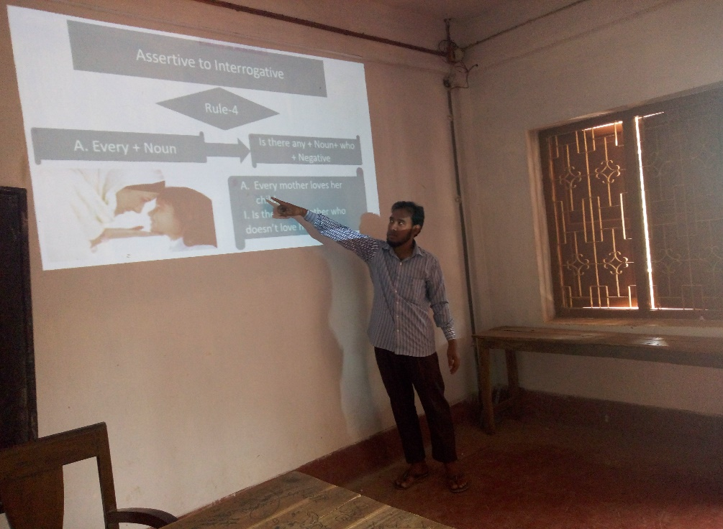
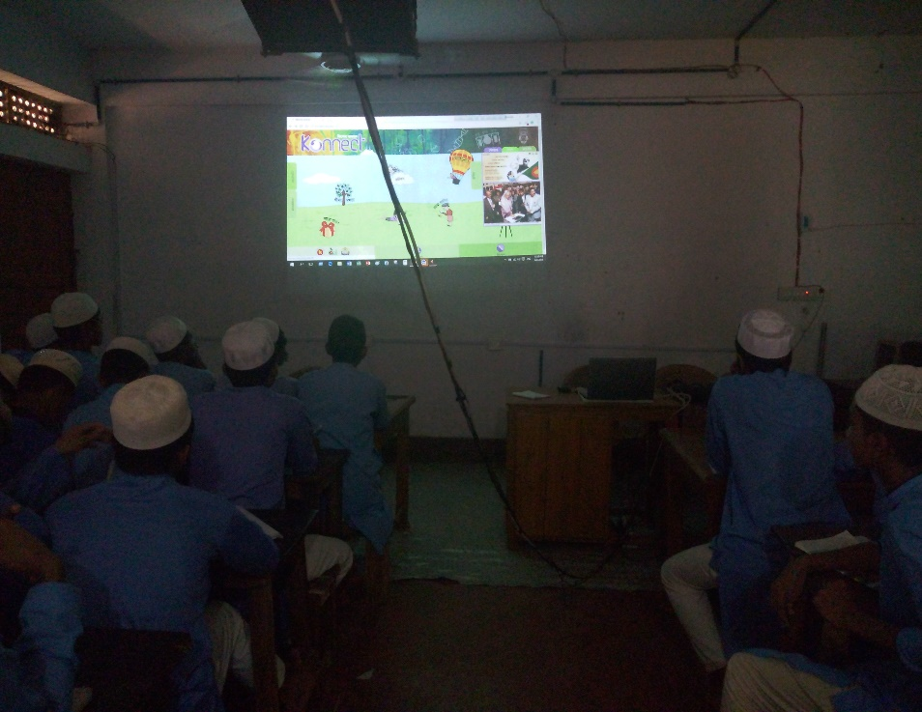
I always try to use technology in teaching and believe that the using of technology is very important for the teachers of 21st century.

Slide 6
I work with Microsoft products every day but I want to know better implementation in education .

Slide 7
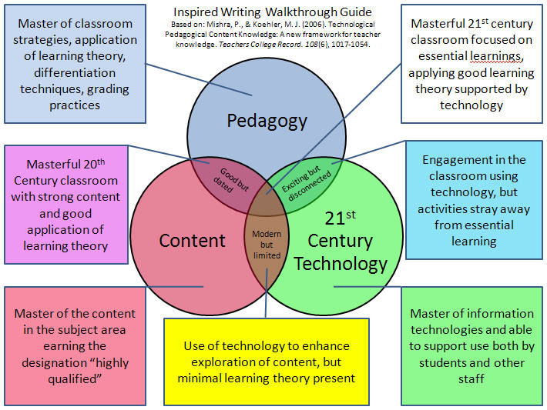
I try to improve my professional skill by Microsoft Education .

Slide 8
I want to share with others the idea of using technology in education what plays an important role in education sector now.

Slide 9
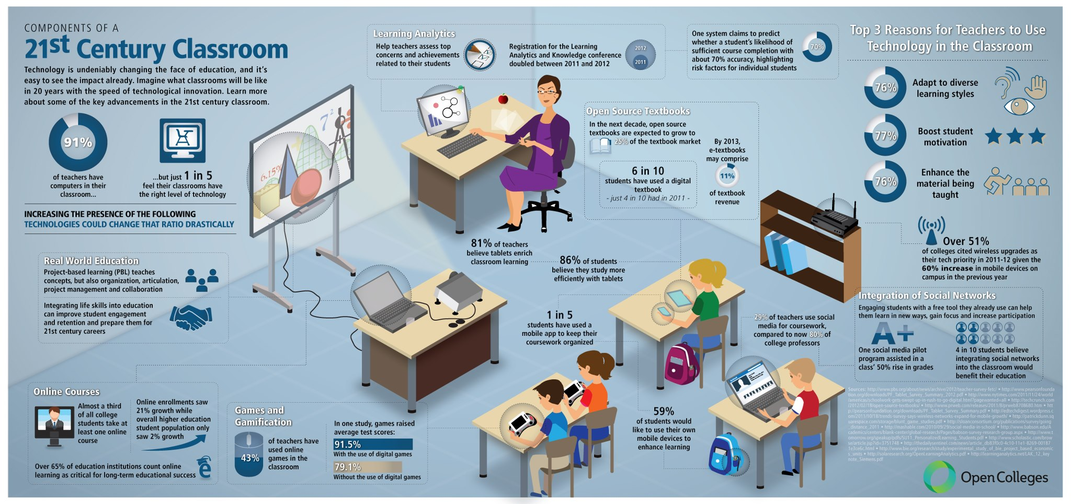
It is my target to make students interested in learning.
and
gain the drop out rate 0%.

Slide 10
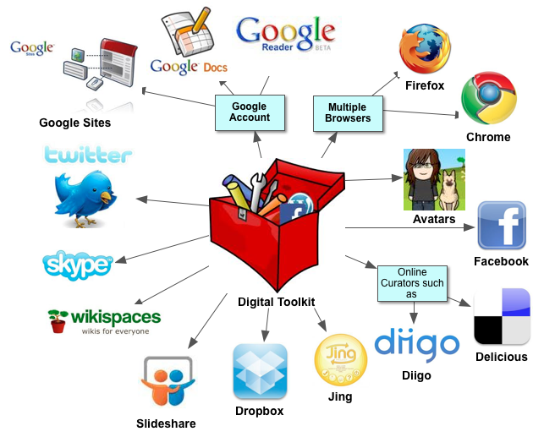
To connect the world network of education
and
hope to be a…

Slide 11
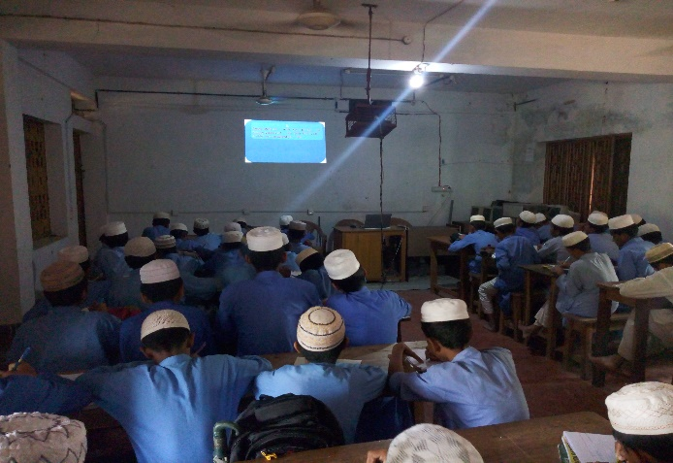
How have I incorporated Microsoft technologies…
In my classroom.

Slide 12
I use Microsoft product in my classroom for…
Making lesson plan.

Slide 13
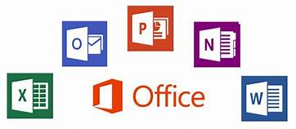
I use Microsoft product in my classroom for…
Making result.

Slide 14
If I will be a……

Slide 15
I will provide training in my school & will be able to change the total traditional educational environment.

Slide 16
I will become more effective in engaging & teaching with technology as a teacher.

Slide 17
I will be able to fulfill all demands of my students & inspire theme to grow in education.

Slide 18
I will be an ideal leader in my school community.

Slide 19
Thank you all.
https://web.facebook.com/showqat.osman.5
https://www.youtube.com/channel/UCB0iRIcePyx9Rt2A6AoSX2w?view_as=subscriber

